Slide 1

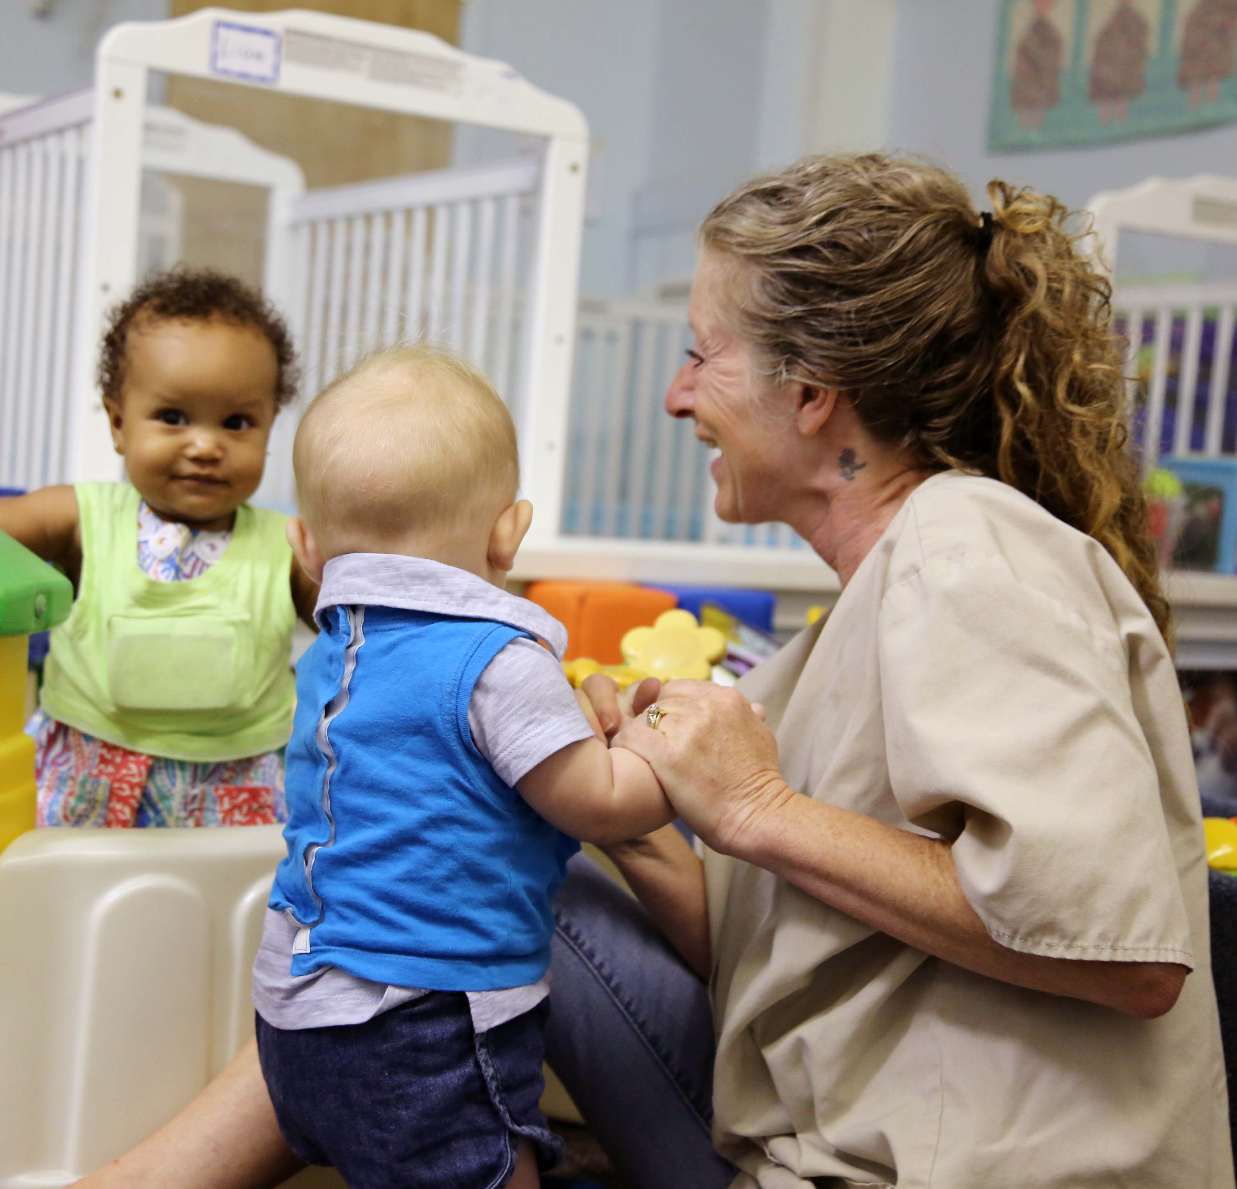
Bringing LENA Grow
to Your Site

Slide 2
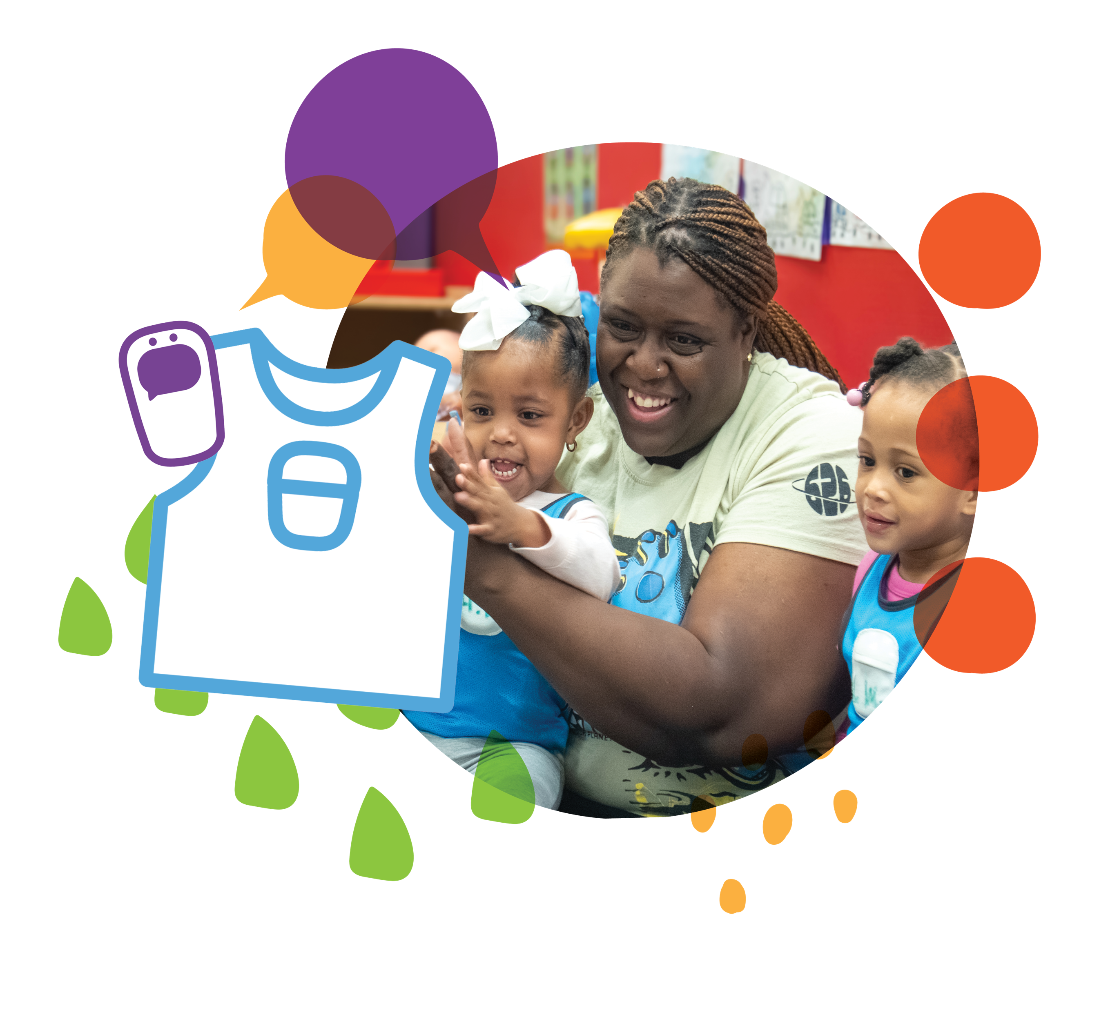
What is LENA Grow?
Professional development program
Increasing interactions between adults and children
Helps build the foundation for learning and development
Notes:
LENA Grow is a professional development program for teachers.
And LENA Grow is all about increasing the interaction between adults and children.
Children learn through everyday interactions with the adults around them.
• When adults and children talk back and forth, it helps children learn to listen, think, respond, and communicate.
• These everyday interactions help build the foundation for learning and development.

Slide 3
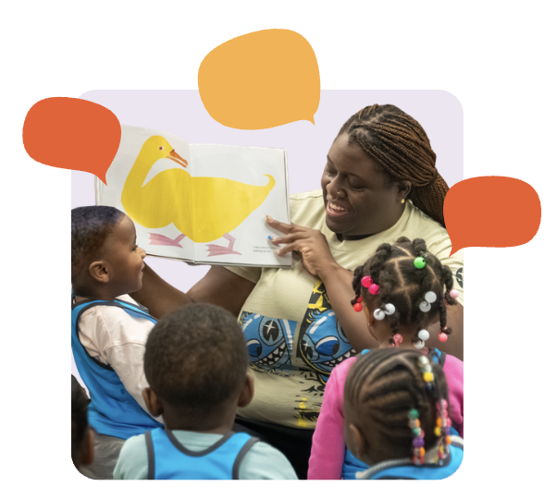
Why conversations matter
Conversations help children build:
💬 Language and literacy skills
❤️ Emotional understanding
🧠 Working memory and critical thinking
😁 Self-regulation
Notes:
• Research shows that conversational turns help children build:
Language and literacy skills
Emotional understanding
Working memory and critical thinking
Self-regulation
• LENA Grow helps teachers create more opportunities for these meaningful interactions throughout the day.

Slide 4
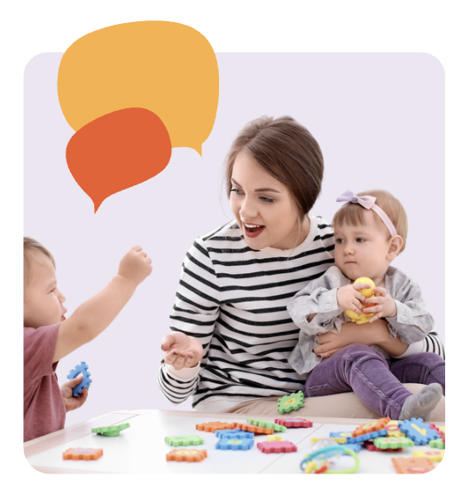
How will LENA Grow benefit our site?
For teachers:
Increase interactions
Individualize teaching strategies
Measure child and classroom progress
Make lasting changes to their teaching practice
Notes:
• Bringing LENA Grow to our site gives teachers the data and strategies they need to create a high quality language environment.
LENA supports teachers as they:
• Increase interactions
• Individualize teaching strategies
• Measure child and classroom progress
• Make lasting changes to their teaching practice

Slide 5
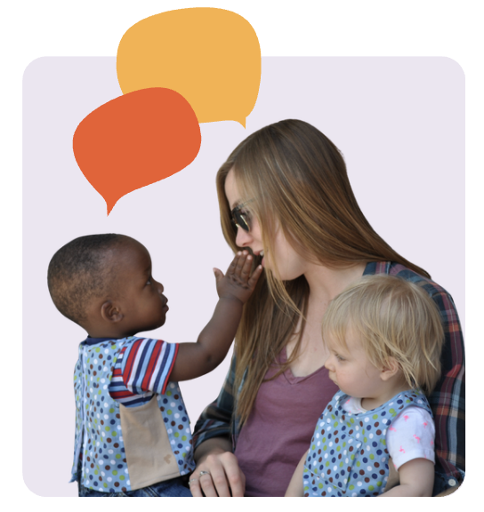
How will LENA Grow benefit our site?
For children:
New/more words
Better able to express feelings
Stronger relationships
Fewer challenging behaviors
Notes:
Children also benefit from participating in LENA Grow.
LENA supports children in:
• Developing language and communication skills
• Learning and using new and more words
• Expressing their thoughts, feelings, and needs
As communication skills grow, children are often better equipped to navigate challenges and build positive relationships with others.

Slide 6
Positive outcomes
More confidence
in teaching abilities
Positive changes in language development
2x
90%
92%
More likely to be kindergarten ready
Notes:
Participating in LENA Grow leads to positive outcomes for our entire community: teachers, children, and families!
• 90% of teachers feel more confident in their teaching abilities, leading to better classroom quality and higher teacher retention rates.
• 92% of teachers saw positive changes in children's language development.
• Children who participate in LENA Grow are 2x more likely to demonstrate kindergarten readiness, especially in language and literacy

Slide 7
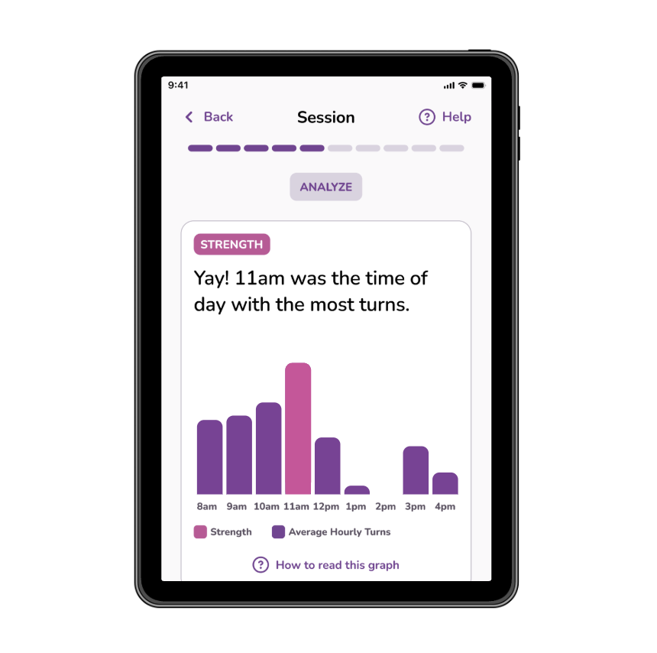
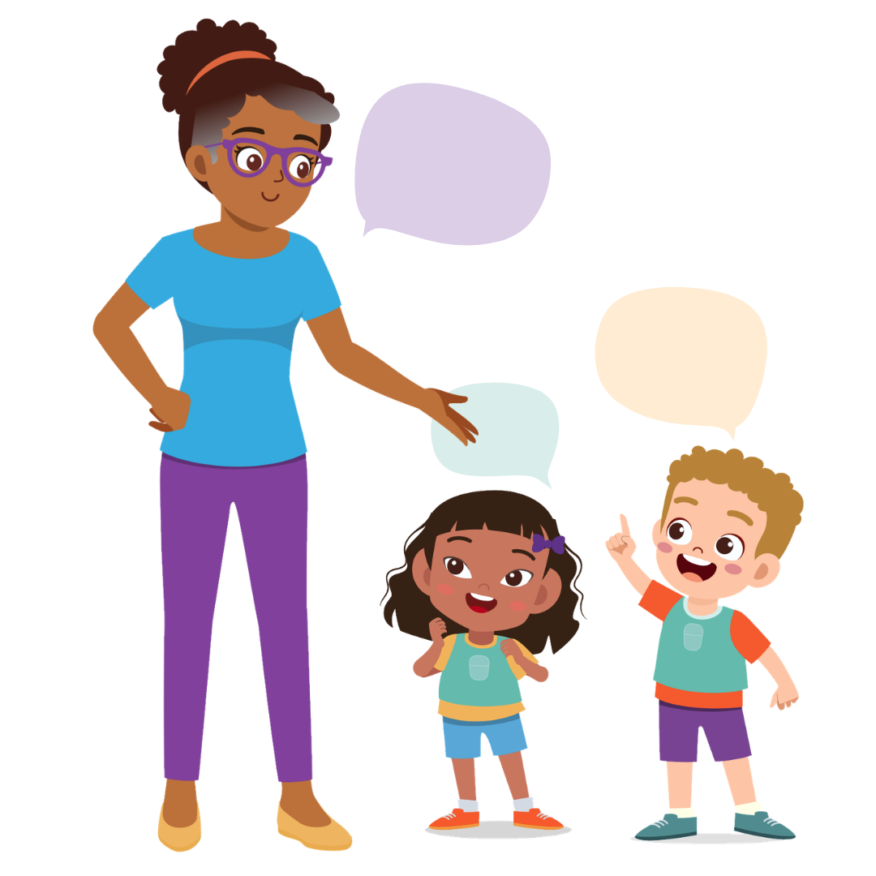
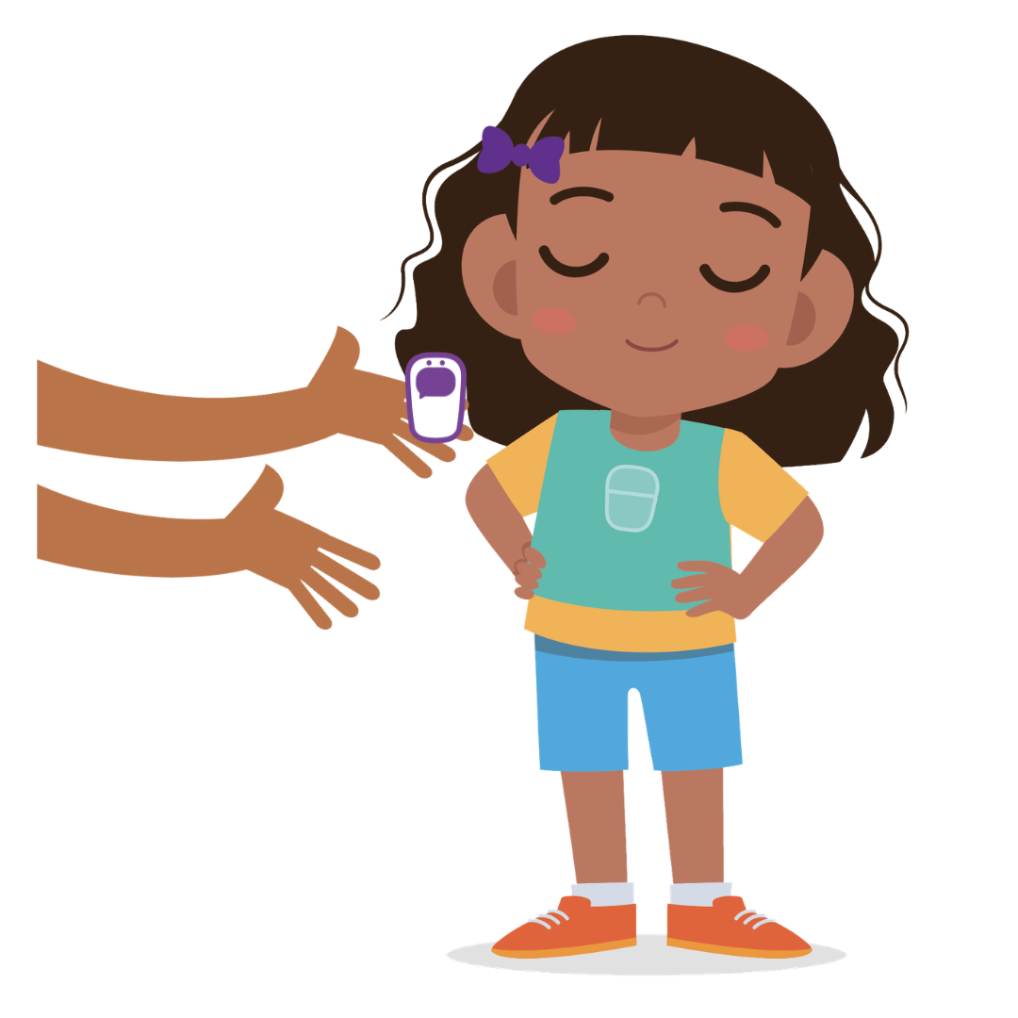
How does LENA Grow work?
Notes:
• LENA Grow is a five-week program that helps teachers increase meaningful interactions with children.
• Once a week, children wear a small, safe device that captures classroom interactions.
• Automated software counts how many words and conversations happen.
• Teachers use this information to help improve learning for your child.
• Families also receive resources with simple ideas for encouraging conversations and meaningful interactions at home.

Slide 8
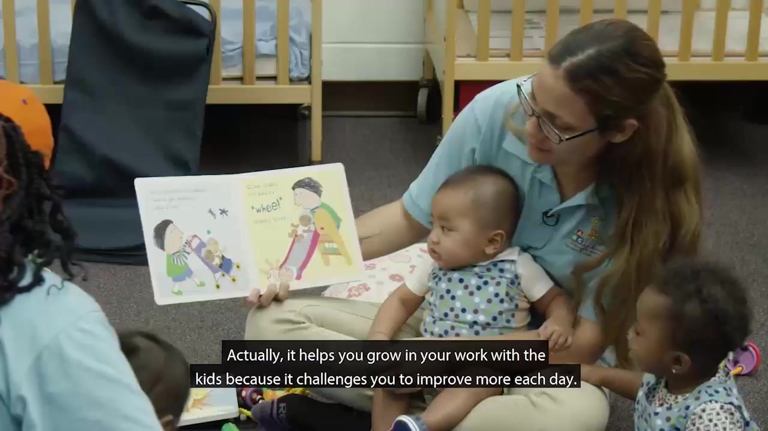
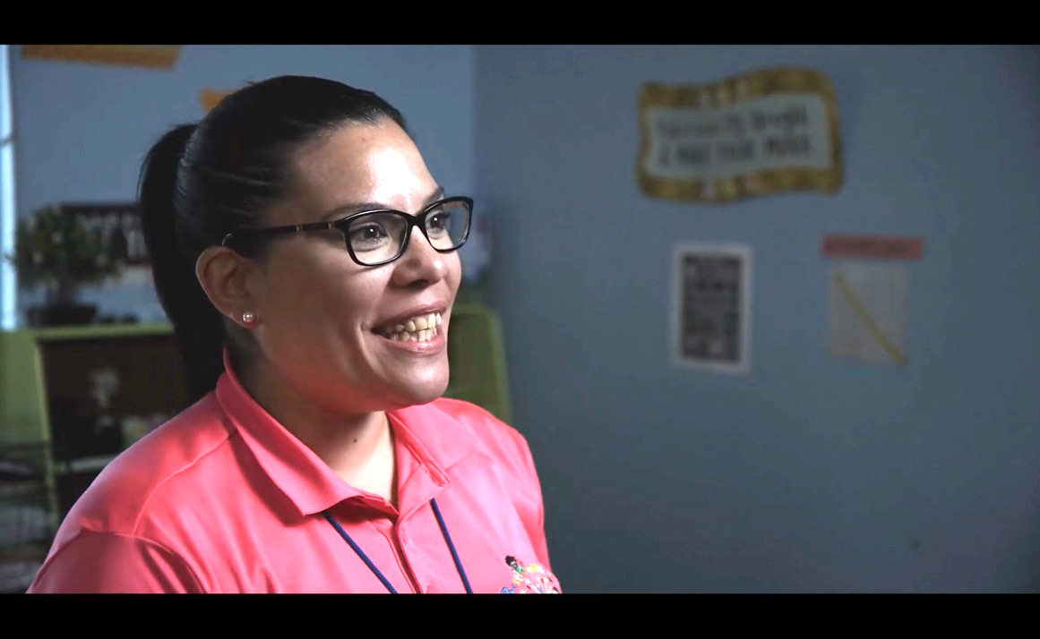

What teachers say about LENA Grow
Notes:
Introduce the video by saying, “Now we’ll have a chance to hear from real teachers who have completed the LENA Grow program.”
Watch, then discuss, “What Teachers are saying about LENA Grow” video.
If you have teachers who have been through the program, this is great time to let them share their experiences, too.

Slide 9
What do you need to provide?
We provide: | You provide:
Orientation for teachers
LENA’s “talk pedometer” technology
Teacher and family engagement materials | Support for family engagement
Reports for teachers, families, and directors | Support for teachers on their LENA Days
Notes:
Customize the table above based on what you will provide versus what the center will provide. If applicable, include any program incentives that will be provided.

Slide 10
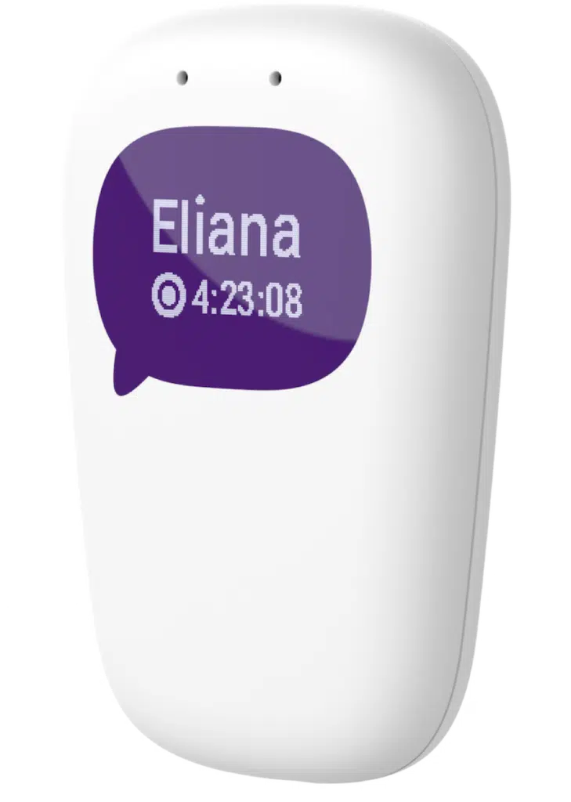
Privacy features
Safe technology designed for young children
No one can listen to recordings
LENA measures interactions, not what children say
Children's information is kept secure and confidential
Notes:
Here are some facts about LENA’s privacy and security:
• The LENA device meets safety rules for electronics and children.
• It does not use Bluetooth or transmit and receive signals.
• The LENA device records audio but cannot play it back.
• The audio is automatically and permanently deleted.
• Audio files are never stored.
• LENA software looks at sound patterns, not word meaning.
It can tell whether a sound was made by an adult, a child, or background noise.
It does not understand words.
• Only people directly helping children learn (teachers, coaches, LENA staff) can see data reports.

Slide 11
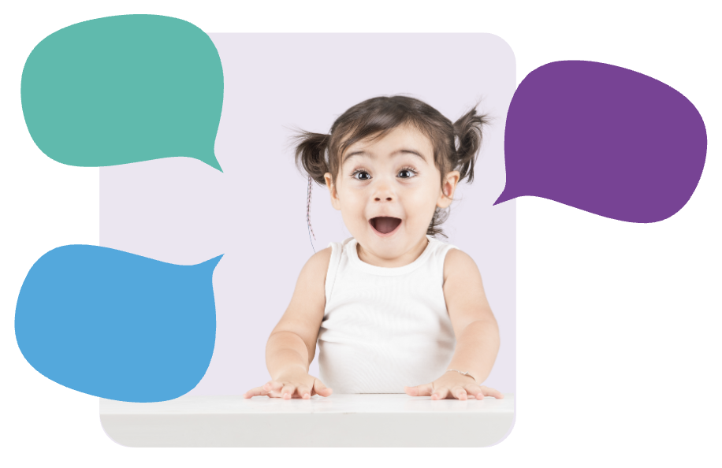
Questions?
How will families learn about LENA?
When do we start?
Is the device safe for children?
Notes:
Some FAQs:
Why is the school or center doing this?
Since conversations (turn-taking) are key to developing brains, we’re measuring them in the classroom to learn how talk can enhance the quality of the language and literacy environment.
Can families learn how to do this at home, too?
Yes! We're all working together to build children’s brains through interaction! We’ll provide Talking Tips and other resources to send home with families so they can learn along with teachers.
Why do we need the LENA vest?
We want to capture all the turn-taking experienced by the children, so the LENA vest goes everywhere they go all day. To accurately measure a child’s speech, the LENA device has to be worn in a fixed position near the child’s mouth. The vest is carefully designed for this purpose.
Is it safe for the child?
Yes — completely. LENA devices are safe for young children, have been in use around the world for more than a decade, and have even been used with premature babies in Neonatal Intensive Care Units [change to hospitals?] for several years. Unlike cellphones, the LENA devices do not transmit (so, no Bluetooth).
Can anyone listen to what is happening in the classroom?
No: The recordings are deleted immediately after LENA has finished counting words and turns. There is no way for anyone to ever listen to the recording.
What about privacy and security?
LENA meets very strict confidentiality and data security requirements. Learn more at LENA.org/privacy-policy.

Slide 12
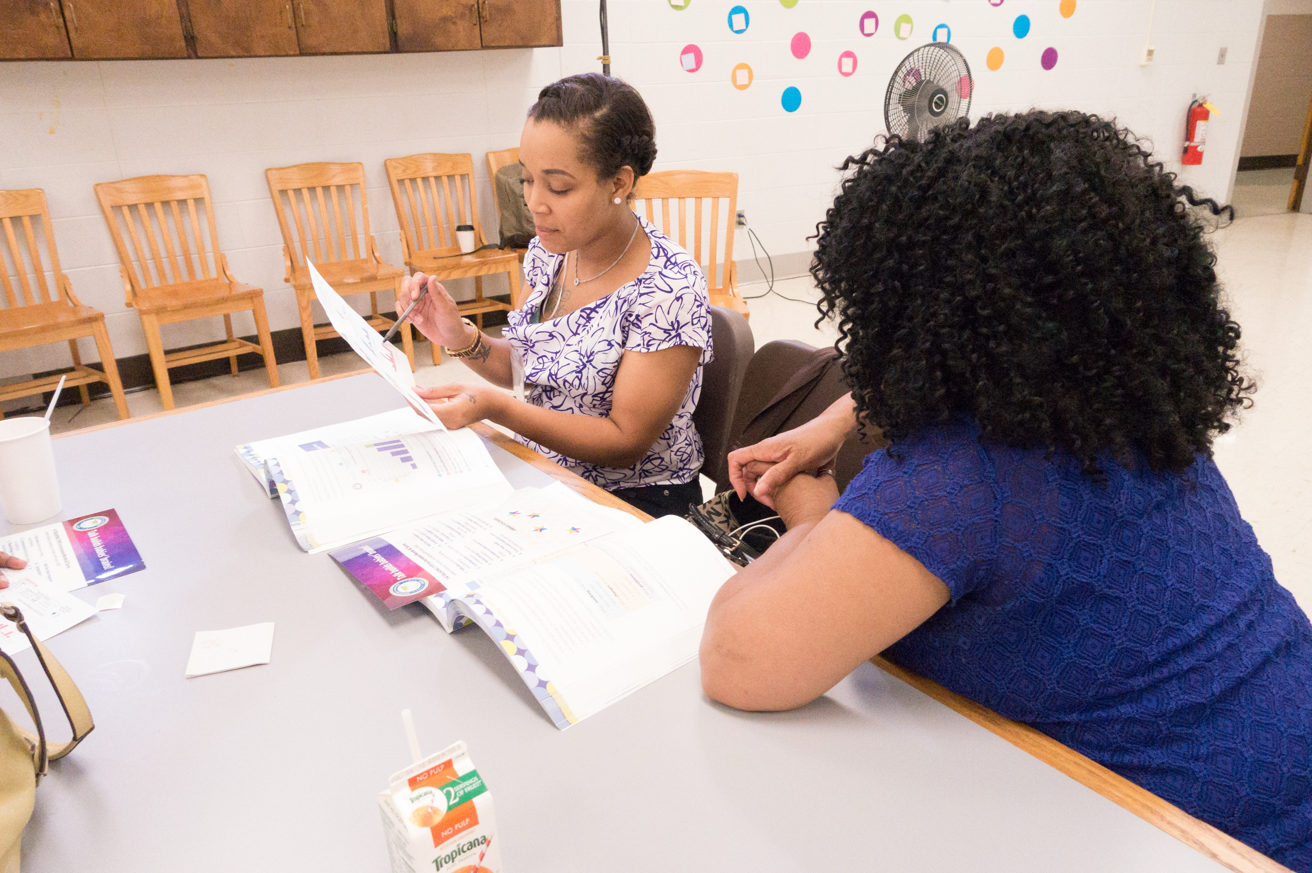
What’s next?
Plan your schedule for teacher participation
Plan a date for Orientation
Notes:
Next, plan your timeline for teacher participation. We can work together to determine how many teachers can participate at once, and when to schedule the 5-week sequences throughout the year so that all your teachers can participate.

Slide 13
Resources
Technology
How LENA Technology Works
About the program
What are Conversational Turns?
Alignments
LENA Grow in Head Start
LENA Grow Increases CLASS® Scores
Notes:
For presenters: Here are some additional resources that may be helpful to review as you prepare this presentation. Reach out to your LENA Grow Partner Success Manager for additional questions as they come up.

