Slide 1
Families: Welcome to LENA Grow!
Notes:
Preparation:
Have a LENA Device and LENA clothing on hand to show families the technology firsthand.
Hang the Talking Tips poster where families can see it. If welcoming families virtually, hang it behind you so it can be seen in the video.
Time:
This presentation should take no more than 20 minutes. If you need to shorten it, we recommend skipping the video “What Teachers Say about LENA Grow.”

Slide 2
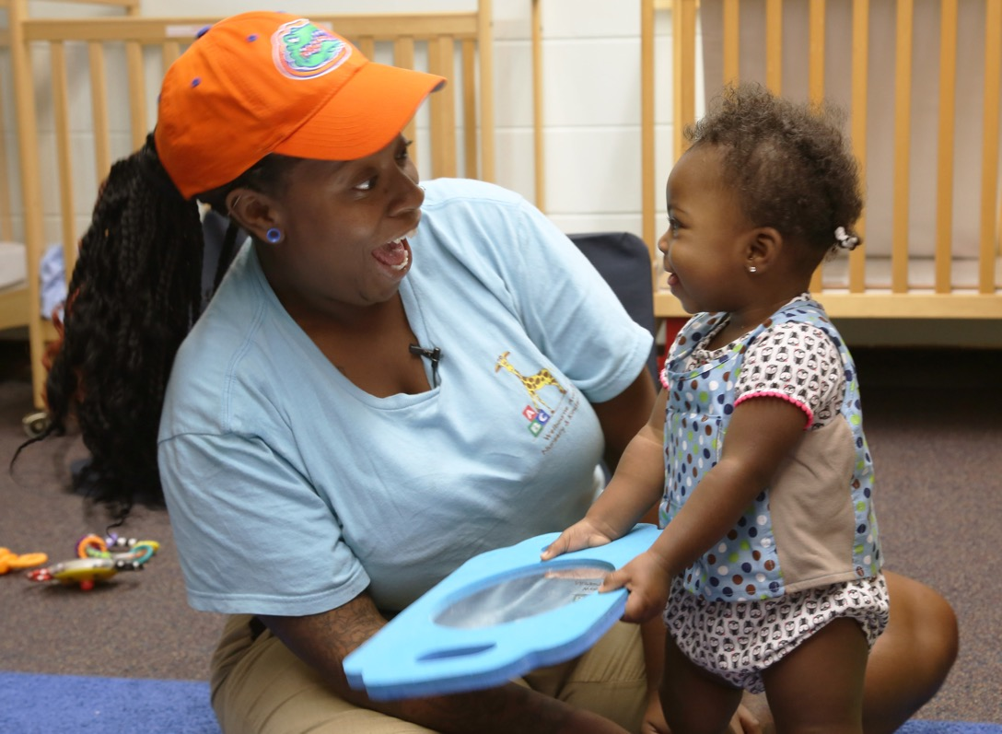
What is LENA Grow?
Notes:
LENA Grow is all about the interaction between adults and children. These interactions, or back-and-forths, are important because they help your child learn and grow.

Slide 3
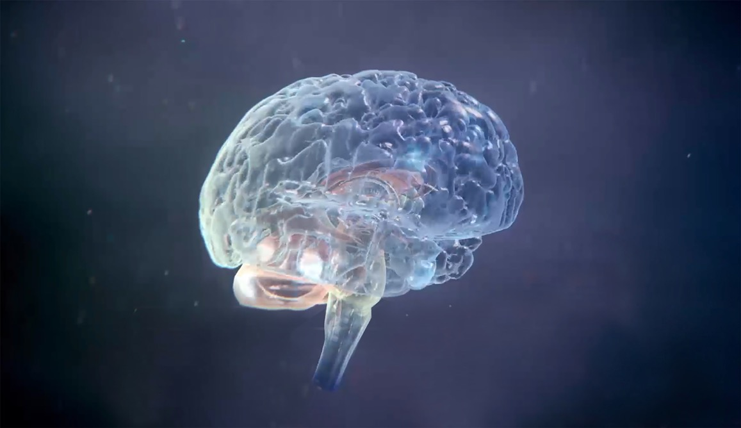
It’s All About Your Child’s Brain
One million new nerve connections every second!
Notes:
The reason we’re doing LENA Grow is all about your child’s brain.
The first few years of life are a critical time for the brain’s rapid growth and development.
Right this minute, your child’s brain is building more than one million nerve connections every second!
And the most important thing you and other adults can do to help build strong connections is TALK WITH YOUR CHILD.

Slide 4
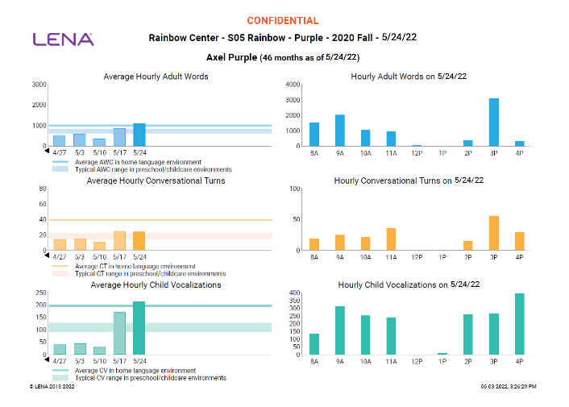
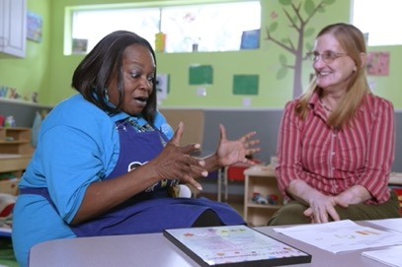

How Does LENA Grow Work?
Talk pedometer
measures talk
Reports
show children’s talk experiences
Resources
support talk
Notes:
LENA Grow is a 5-week program that gives teachers additional information about each child they are caring for and teaching.
During each “LENA Day,” all participating children wear a LENA device, which is like a talk pedometer, to capture their individual language or talk experiences throughout the day.
Then, LENA software counts words and turns and creates feedback reports about the day.
Teachers will have a chance to review reports weekly, learn tips to increase back-and-forth talk with children, and set goals.
You will also get to see reports and will receive ideas (Talking Tips) to help spark ideas for more talk at home.

Slide 5
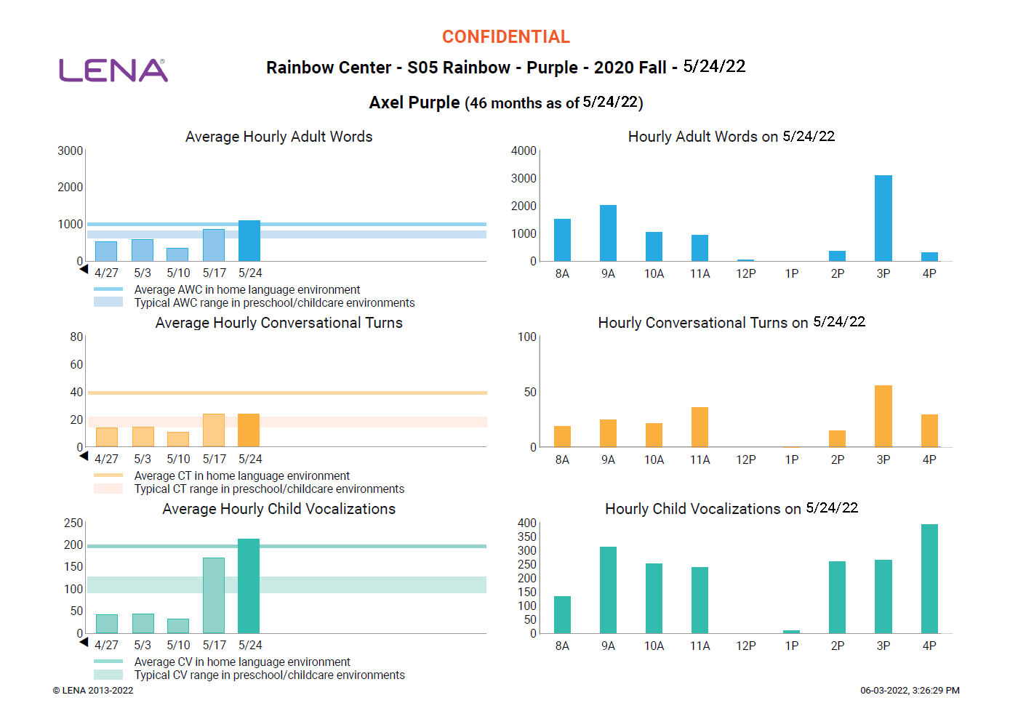
Privacy Features
Audio is deleted right after words and turns have been counted.
No one can ever listen to it.
No one knows what’s being said or the meanings of words.
Counts are turned into a report.
Notes:
Read the slide
You can compare how LENA works to sitting in a restaurant next to a family that’s speaking a language you don’t know or understand — you just know when they are talking, but you don’t know what they’re saying.

Slide 6
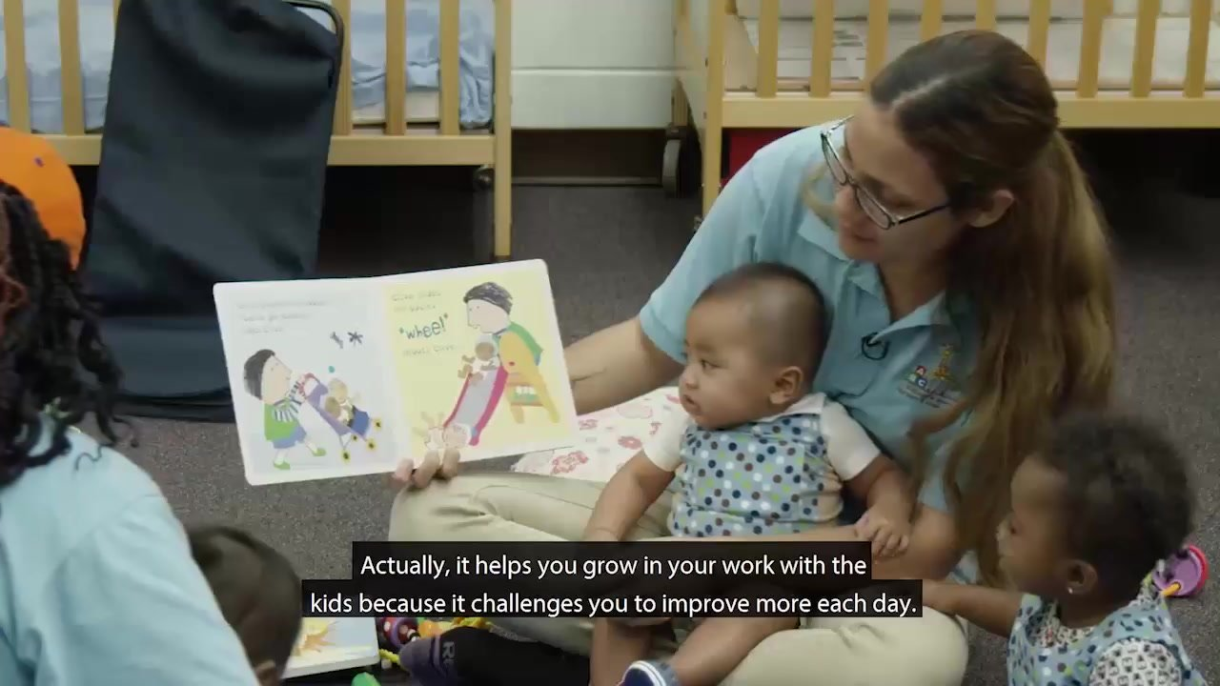
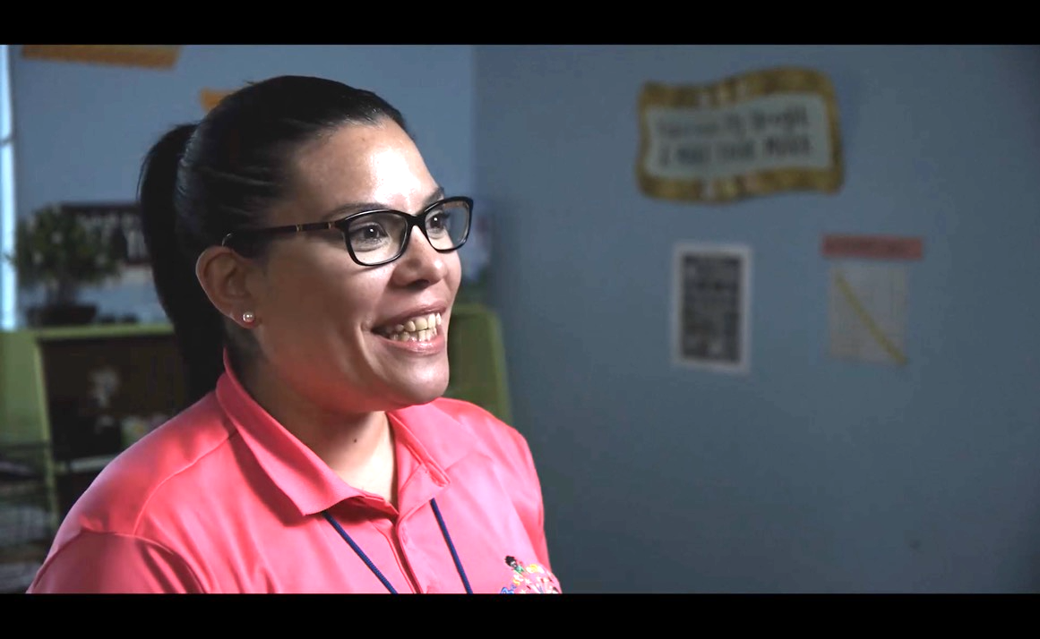

What Teachers Say About LENA Grow
Notes:
Introduce the video by saying, “Now we’ll have a chance to hear from real teachers who have completed the LENA Grow program.”
Watch, then discuss, “What Teachers are saying about LENA Grow” video.
If you have teachers who have been through the program, this is great time to let them share their experiences, too.

Slide 7
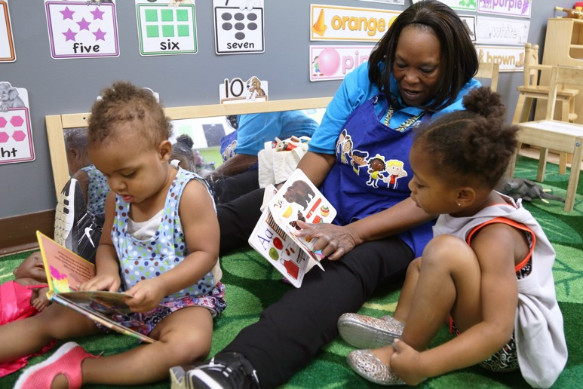
How Will This Benefit My Child?
New/more words
Increased confidence
Stronger relationship with teacher
Better able to express needs, feelings
Fewer challenging behaviors
Notes:
LENA Grow is a professional development program for early childhood teachers. It uses advanced technology to help teachers learn about patterns of talk in their classrooms.
LENA Grow uses unique “talk pedometer” technology to measure talk in the classroom, to help teachers provide a more language-rich and interactive environment for your children.
During the program, you can learn along with us. You’ll receive regular reports and resources to use at home, too. We will all continue to help build your child’s brain together!
Children who have participated in LENA Grow have seen the following benefits:
Saying more words and saying new words
Increased confidence
Stronger relationships with their teacher
They are better able to express their feelings and needs, which can lead to fewer challenging behaviors

Slide 8
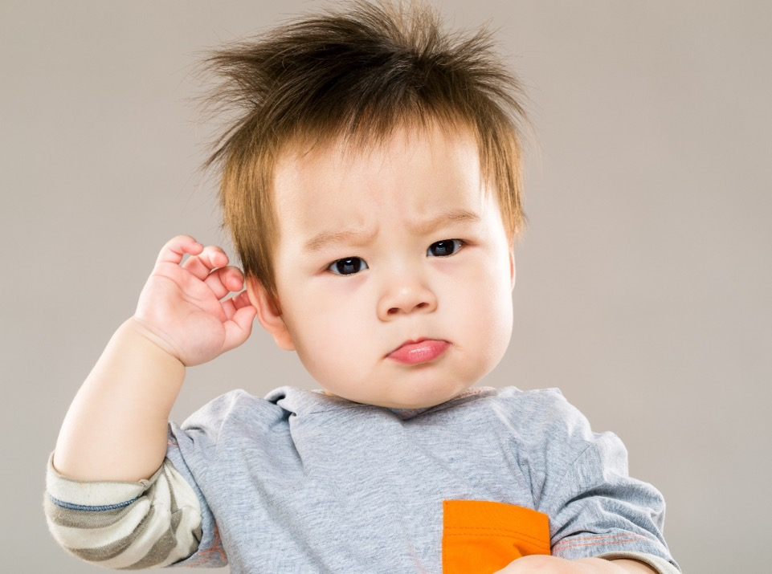
Questions?
Can I learn how to do this at home, too?
Why is this important?
How long does the program last?
Is this safe for my child?
Notes:
Some FAQs:
Why is the school or center doing this?
Since conversations (turn-taking) are key to nourishing early brain growth, we’re measuring them in the classroom to learn how talk can enhance the quality of the language and literacy environment.
Can I learn how to do this at home, too?
Yes! We're all working together to build your baby’s/child's brain through interaction! We'll send home Talking Tips and other resources so you can learn along with us. If you also have LENA Start (parent-group sessions) offered in your program or community, share information about how to register to participate in the program with other parents and measure interaction at home.
Why do we need the clothing?
We want to capture all the turn-taking experienced by your child, so the LENA clothing goes everywhere your child goes all day. To accurately measure a child’s speech, the LENA device has to be worn in a fixed position near the child’s mouth. The clothing is carefully designed for this purpose.
Is it safe for the child?
Yes — completely. LENA devices are safe for young children, have been in use around the world for more than a decade, and have even been used with premature babies in Neonatal Intensive Care Units [change to hospitals?] for several years. Unlike cellphones, the LENA devices do not transmit (so, no Bluetooth). They use the same kind of very low-power processors as hearing aids.
Can anyone listen to what is happening in the classroom?
No: The recordings are deleted immediately after LENA has finished counting words and turns. There is no way for anyone to ever listen to the recording.
What about privacy and security?
LENA meets very strict confidentiality and data security requirements. Learn more at LENA.org/privacy-policy.

Slide 9
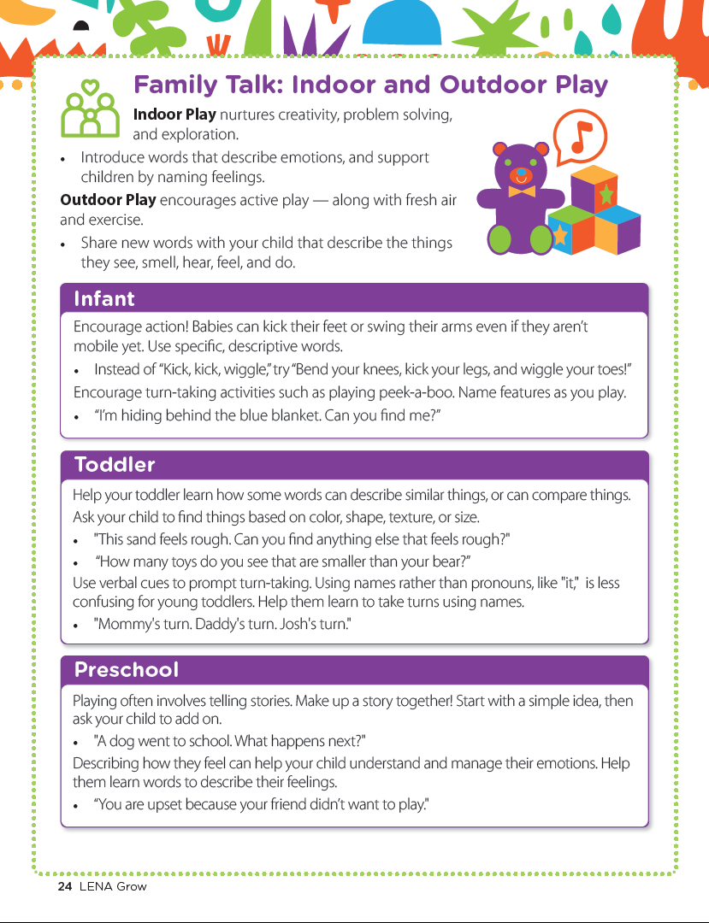
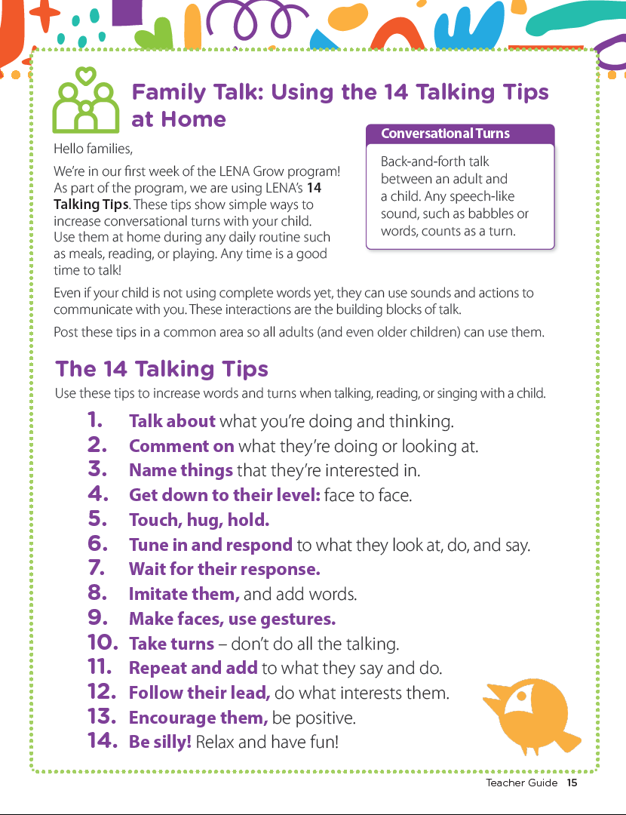
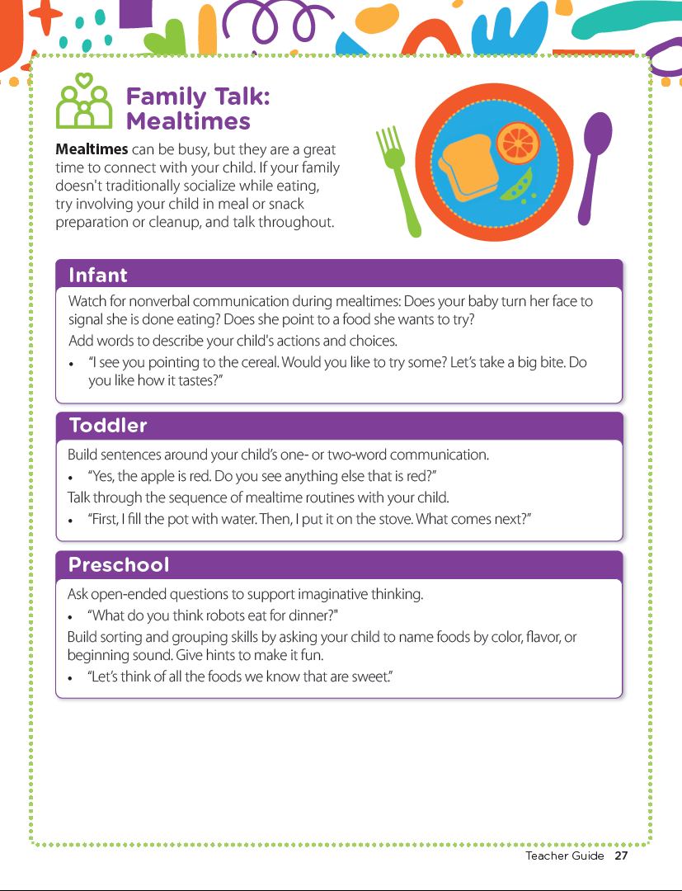
What’s Next?
You will have a chance to learn alongside us!
Notes:
Next, we will start LENA Grow ________________________ (state time frame).
We want you to learn along the way with us! We’ll be sending home some of the same resources we as teachers are using here. We can all work together on our goal of brain-building interactions!

